Slide 1

[Pizza Heist]
Authenticating Network..
Loading Files..
Importing Servers..
Notes:
asdasdsa

Slide 2





An Introduction to Pizza Heist
A hacker themed simulator game that teaches cybersecurity basics.
Technology
Unity & Visual Studio Code
Topics
Password Security, Phishing, and Viruses
Notes:
sadsadasdas

Slide 3
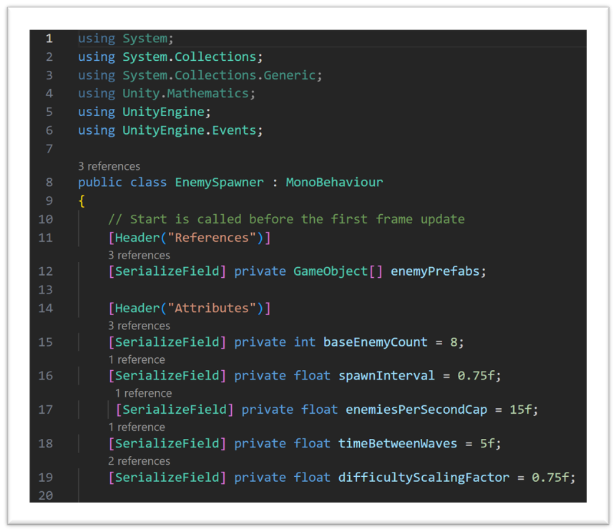
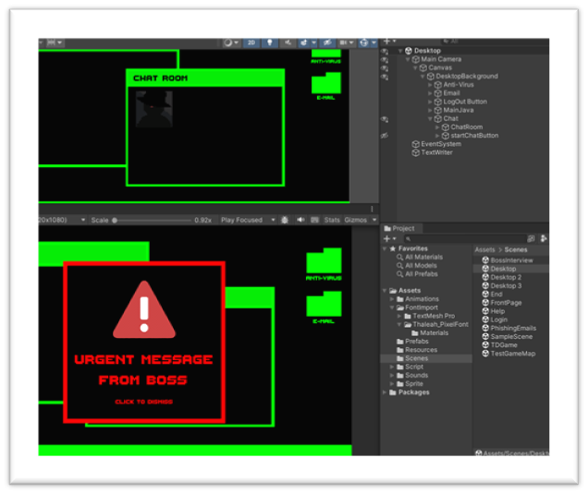
An Introduction to Pizza Heist Cont.
Unity
User Interface
Game Object (Enemies and Towers)
Scripts & Functionality (C#)
Visual Studio Code
Scripts and Code Editor

Slide 4

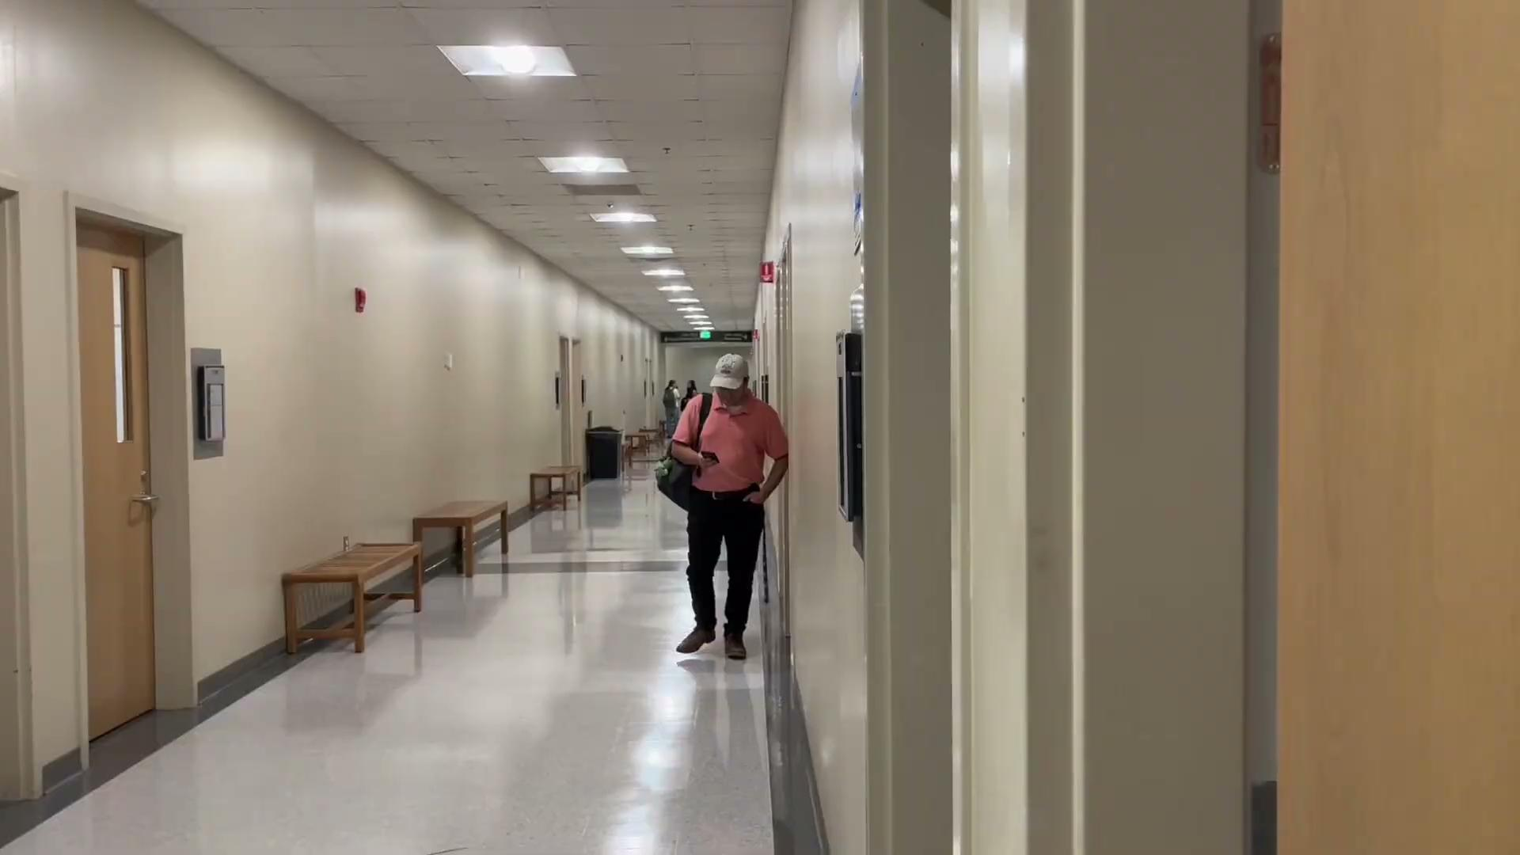

Mission Report
Welcome to your first day on the job where you will be playing as a new hire at Big Caesars in their cybersecurity department.

Slide 5

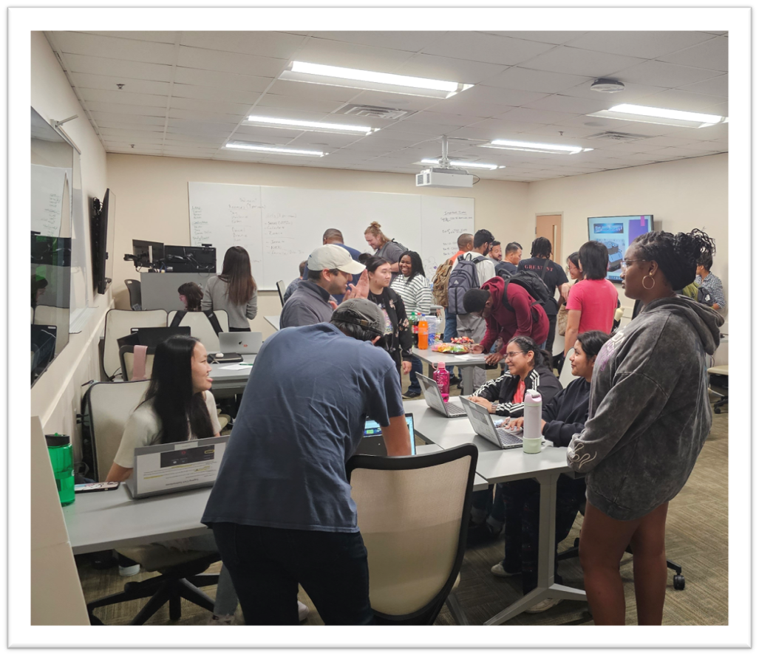
STEC 4800: TAP
Technology Ambassador Program
Aims to increase the number of students pursuing Information Technology (IT) majors & minors
Students develop projects using the technology of their choice and participate in outreach service learning events

Slide 6
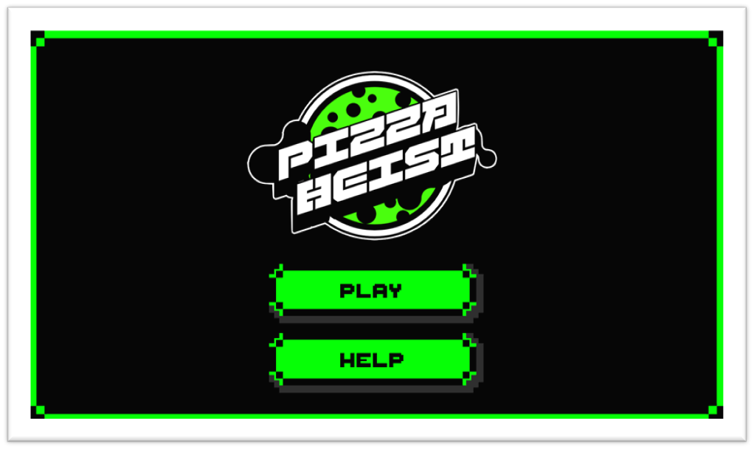
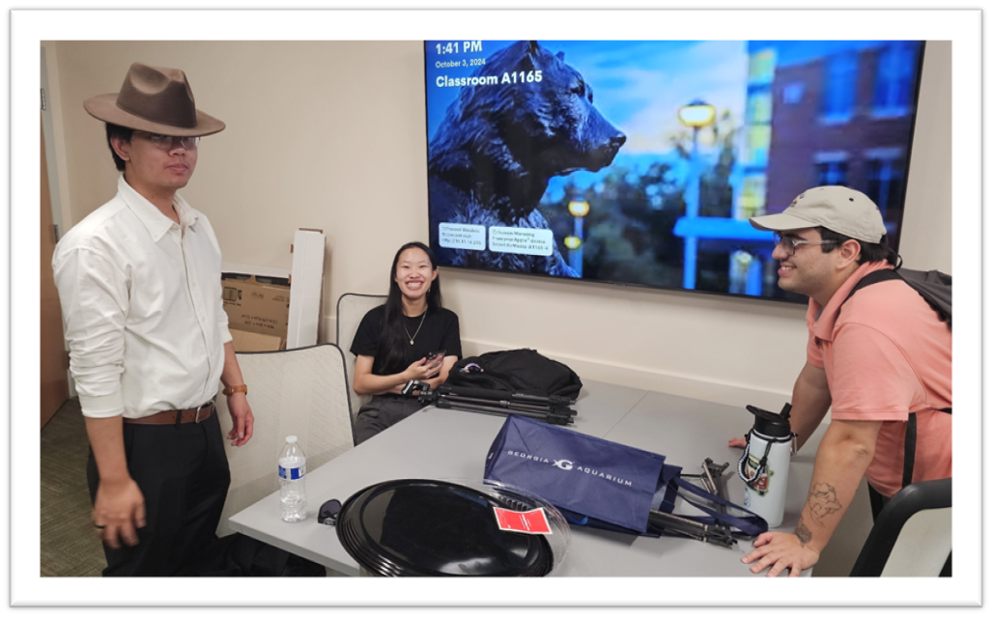
Goals
This study aims to educate middle school, high school, and college students about the existence of malicious entities and how to prevent their data from being breached
Create a learning space along with a fun and entertaining environment.

Slide 7
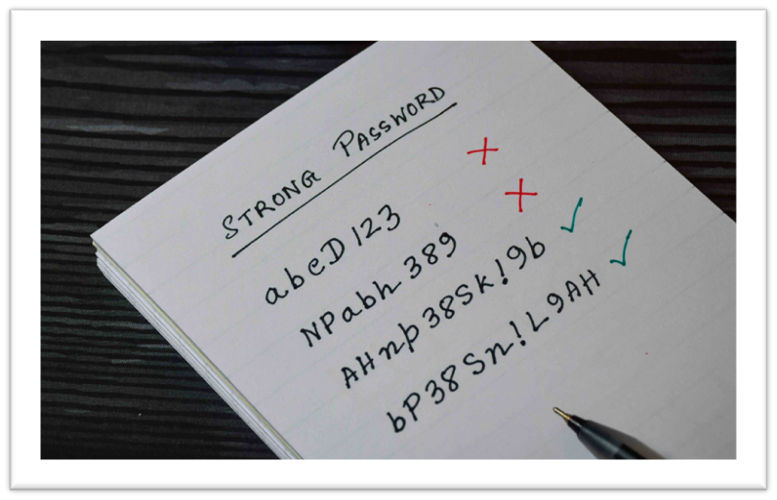

Password Security
Why do you need a secure password?
Identity Theft
Sensitive Information
Full name, birthday, home address, etc.
How to keep it secure?
Don’t share it with friends or family
Never send a password via email, instant message, or any other forms of communication that is not secure
Use a unique password for different accounts
What makes a secure password?
Using a combination of uppercase and lowercase letters, numbers, and symbols
At least 12 characters
Avoid using common dictionary words, names, and personal information

Slide 8

Password Examples
Unsecure Passwords
AgentPepperoni
Towerdefense
Secure Passwords
AgentP3pperoni#47
d@nnyPlaysT0werDef6

Slide 9
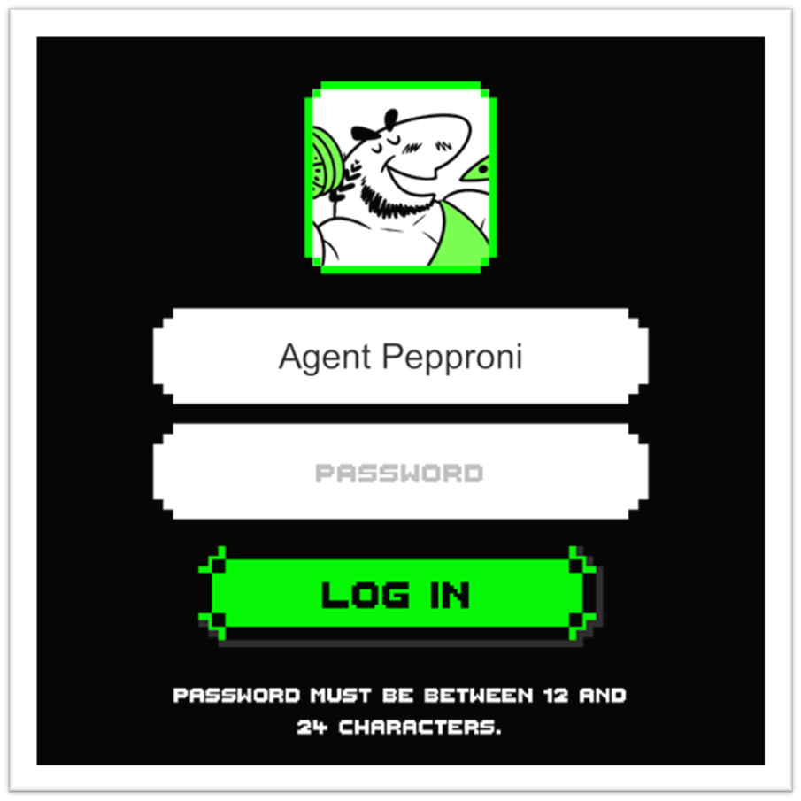

Account Log In
Username
Give yourself a user or codename
Password
Create a secure password using the requirements
You will get an error message notifying you what your password still needs

Slide 10


Phishing
Fish? No, Phish!!
When hackers impersonate reputable companies in order to steal data and sensitive information
Most commonly found in emails, suspicious websites, phone calls/texts
The sneakiest way to steal your data, install malware, or just mess around with you and do damage!

Slide 11
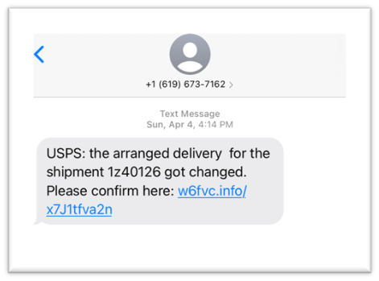
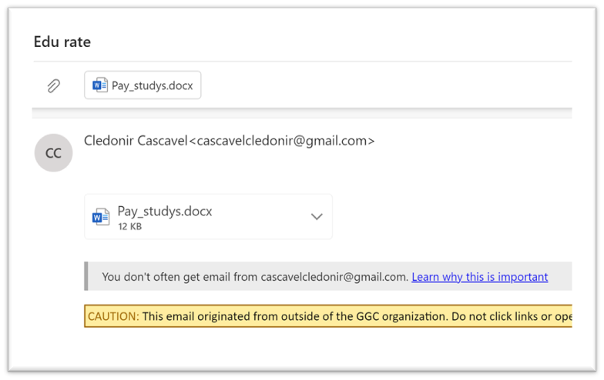
Phishing Examples
Identifiers
Suspicious links/files
Lack of content in emails
Unknown contacts
Incorrect grammar and punctuation
Remember
Were you expecting a message from that person/organization?
If it’s too good to be true, it probably is
If you’re worried, contact that person/organization through their known forms of contact

Slide 12
Spot The Difference: Find the FAKE URL
www.amaz0n.com OR www.amazon.com
www.amaz0n.com OR www.amazon.com
www.steamcommunity.com OR www.steamconnnunity.com
www.steamcommunity.com OR www.steamconnnunity.com
www.robIox.com OR www.roblox.com
www.robIox.com OR www.roblox.com

Slide 13

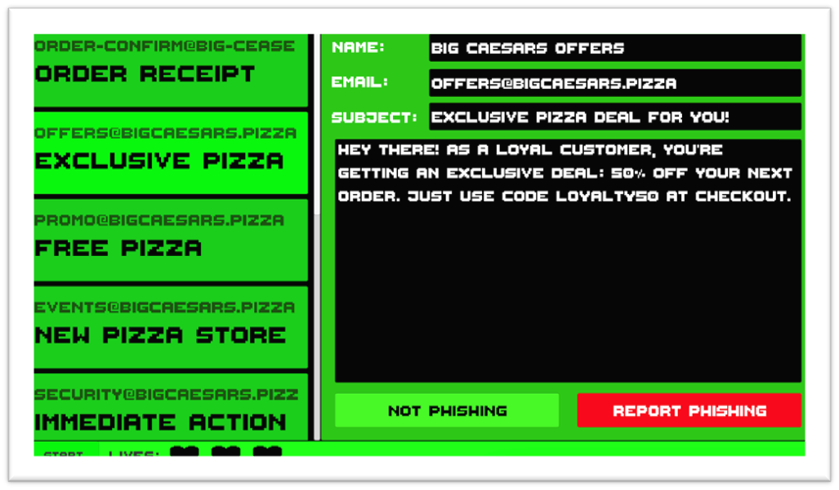
Phishing Game
To be scammed or not to be?
Boss wants you to sort through the shop’s email
Some emails are phishy and some are not
Read all elements of the email carefully
Goal of the game:
Clear out the inbox and correctly mark all the phishing emails to continue

Slide 14
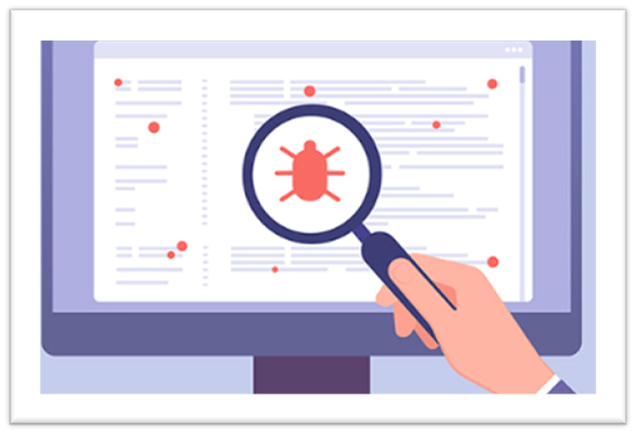
Viruses and Anti-Viruses
What are viruses?
Viruses are a type of malicious software (malware) designed to attack and execute harmful actions, such as corrupting data, stealing personal information, or disrupting system operations.
What are Anti-Viruses?
A program designed to detect, prevent, and remove malicious software (malware) from computers and networks
It protects systems by scanning files, monitoring system behavior, and identifying known malware signatures

Slide 15



Viruses
Worm
Are commonly self-replicating viruses that spreads itself across the internet. This kind of virus targets the internet in order to gain access to computers.
Malware
A common form of viruses that attack your system in order to gain access to information you have.
Denial-of-Service (DoS)
A type of cyber attack aimed at making a network service unavailable to its intended users by overwhelming it with a flood of illegitimate requests or generating traffic.

Slide 16



Viruses
Trojan Virus
A type of malicious software that disguises itself as something legitimate or harmless to trick users into downloading and executing it.
Ransomware
A malicious software that encrypts a victim's data or locks them out of their system, demanding a ransom payment to restore access.

Slide 17



Defenders
Backup
A copy of data or files stored separately from the original. Used to restore information in case of data loss, corruption, or system failure.
Malware Antivirus
Designed to detect, prevent, and remove malicious software (malware) from computers. This is the most basic line of security.
Firewall
A security software that blocks and slows down viruses from breaching into a computer and its network.

Slide 18


Defenders
Network-Based Antivirus
A security solution that scans and protects a network and any connected devices from malware and worms.
Intrusion Detection System (IDS)
A security tool that monitors network or system activities for suspicious behavior or policy violations. It identifies potential security breaches, such as unauthorized access or attacks.

Slide 19
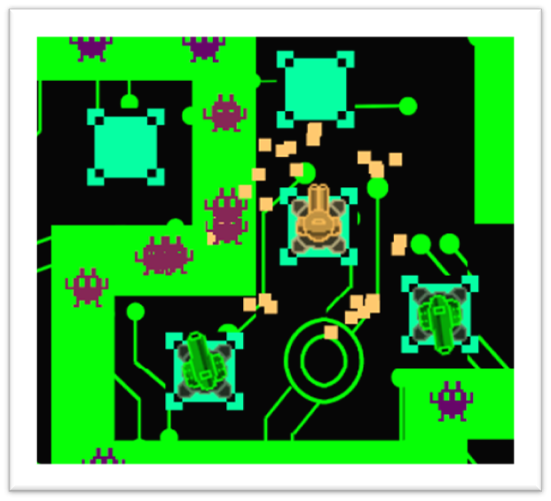

Virus Tower Defense
What is Virus Tower Defense?
A tower defense mini-game that simulates a friendly understanding of the different types of viruses and how to deal with them.
The game creates challenging levels that requires players to use different features and aspects in order to overcome the game.
Goal of the game:
To create something fun and unique to showcase and create awareness for the different viruses and antivirus.

Slide 20
Game Walkthrough

Slide 21
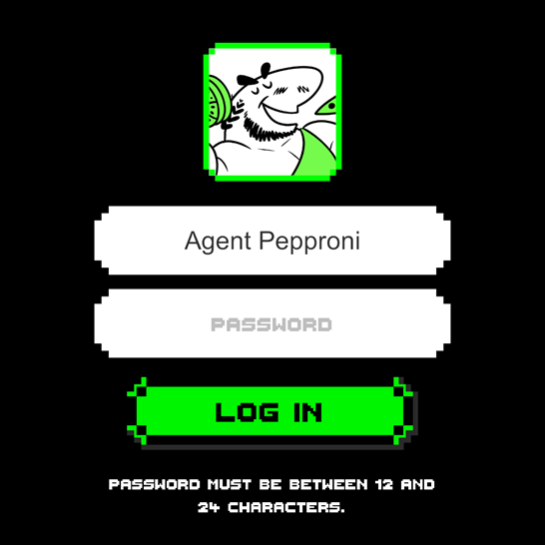
Logging In
Username
Password
Log In Button
Error Message

Slide 22
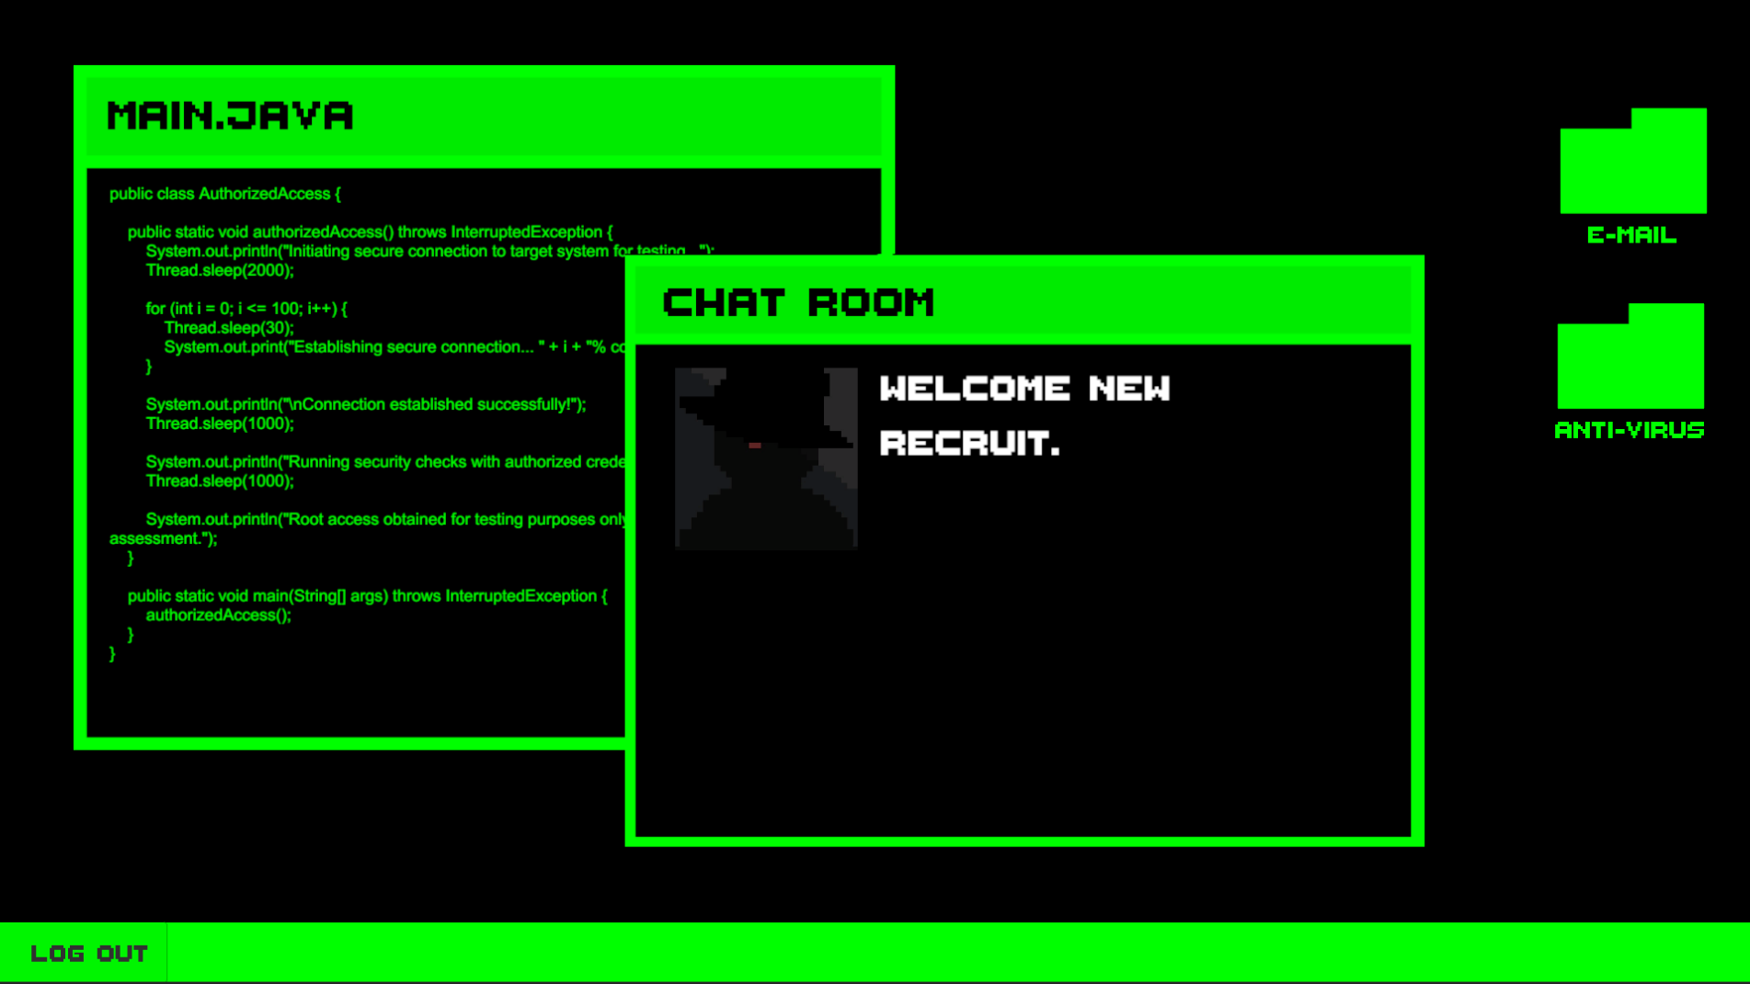
Desktop
E-Mail Folder
Some Cool Looking Code
Anti-Virus Folder
Chat Room
Log Out

Slide 23
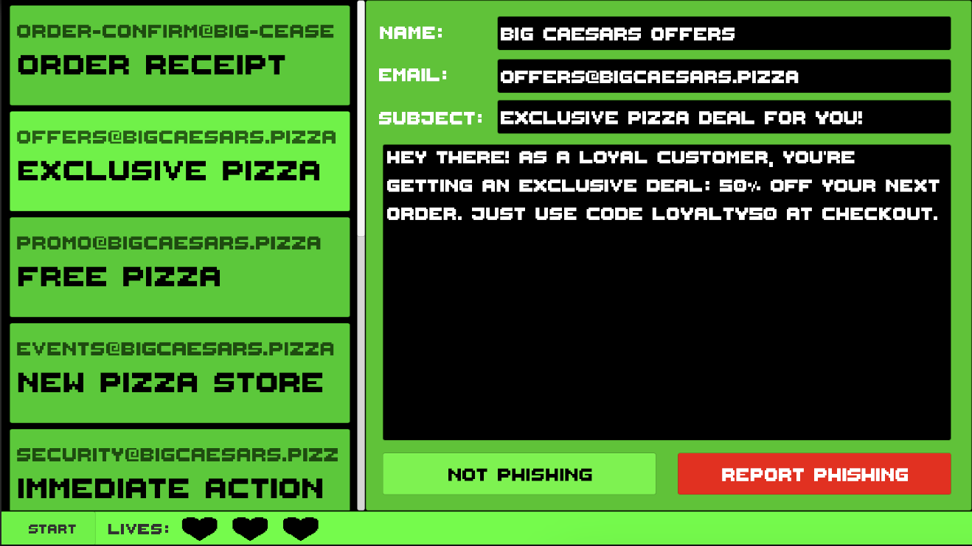
Phishing Game
Email Details
Inbox Pane
Phishing Buttons
Start
Lives

Slide 24
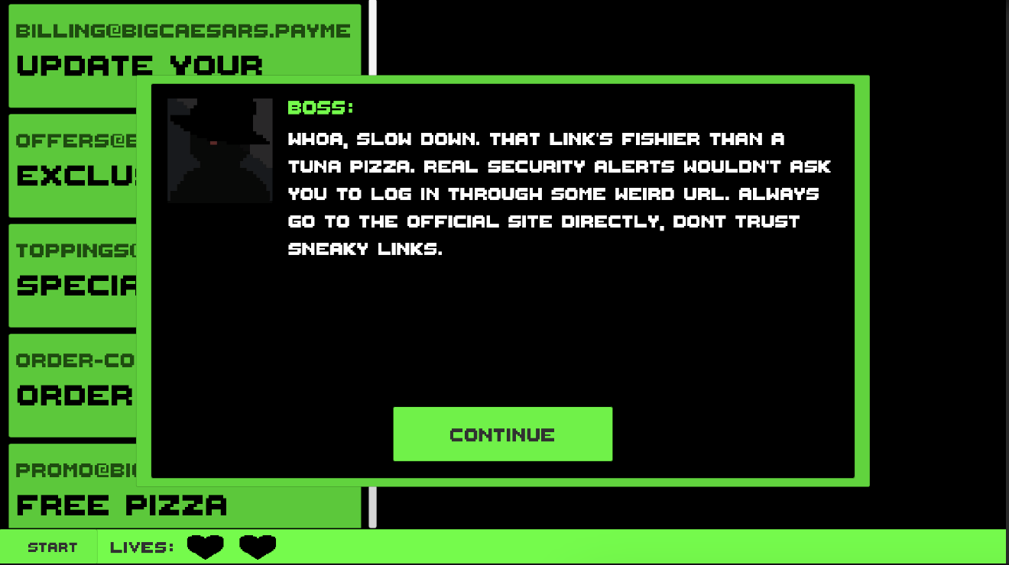
Phishing Game (Incorrect Choice)
Boss will explain if you miss label an email!
Read Carefully!
Lose a Life

Slide 25
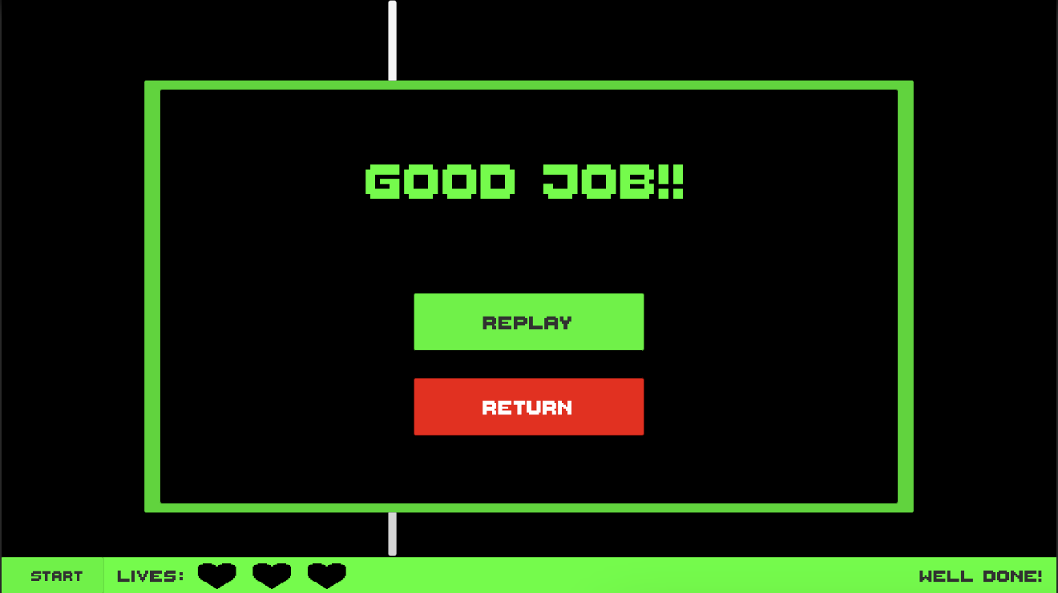
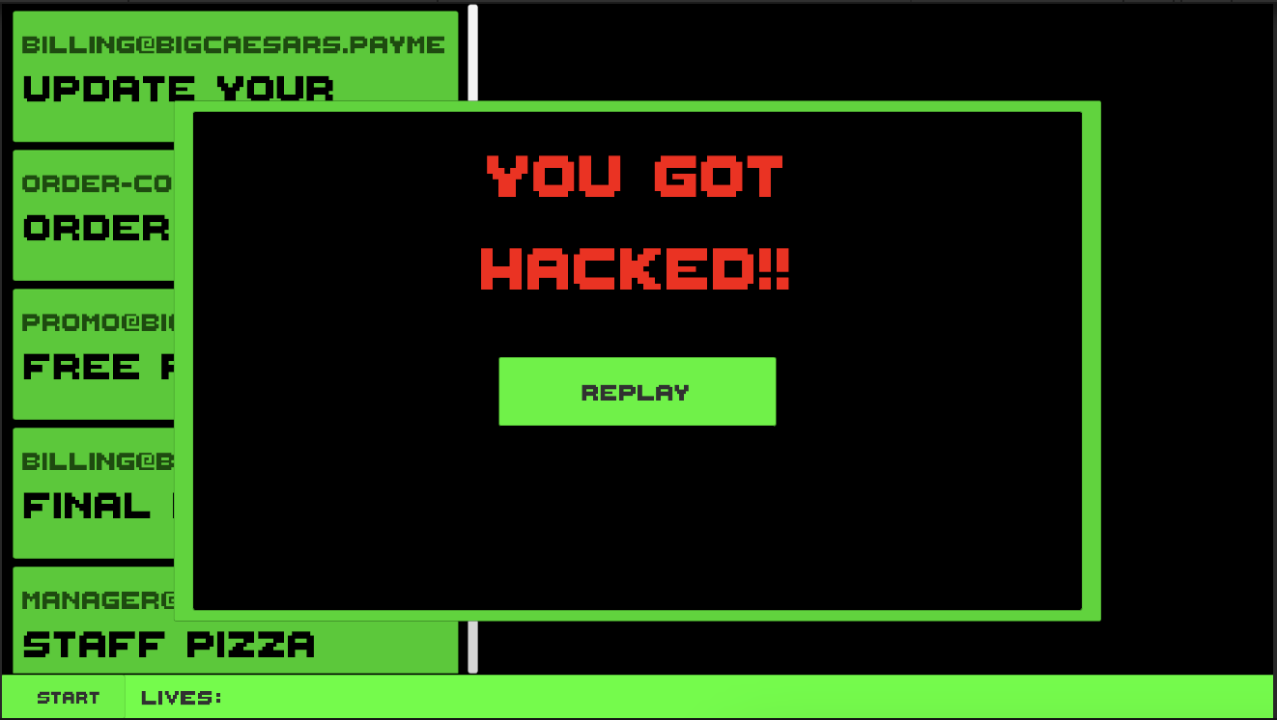
Phishing Game (Endings)
If you lose all 3 lives, your account is compromised!
Clean out the inbox to move on!

Slide 26
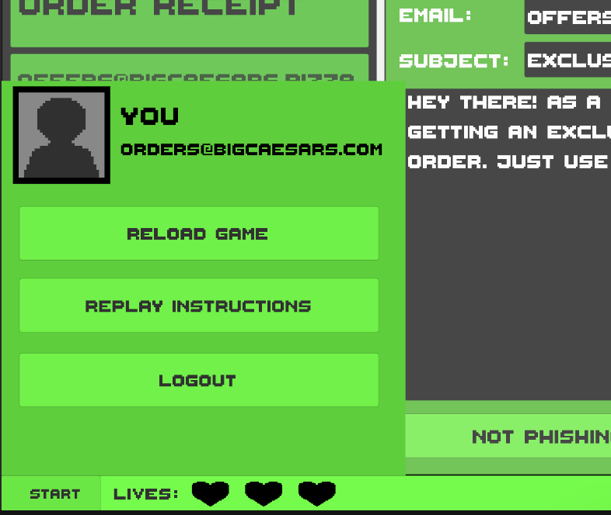
Phishing Game (Extra Tip)
Profile & Domain
If you ever get stuck, open the start menu!
Restart Minigame
Replay Instructions from Boss
Don’t press if you want to make the Boss angry
Start button

Slide 27
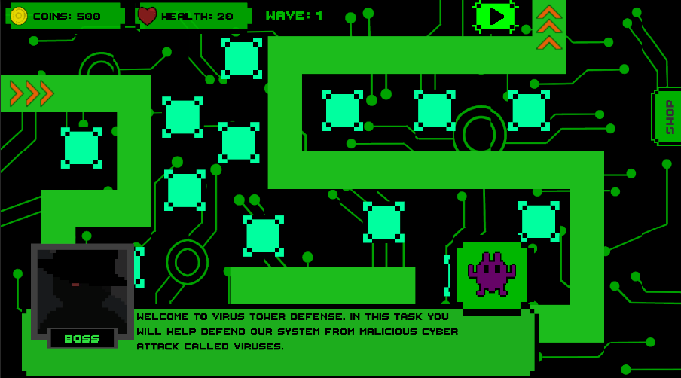
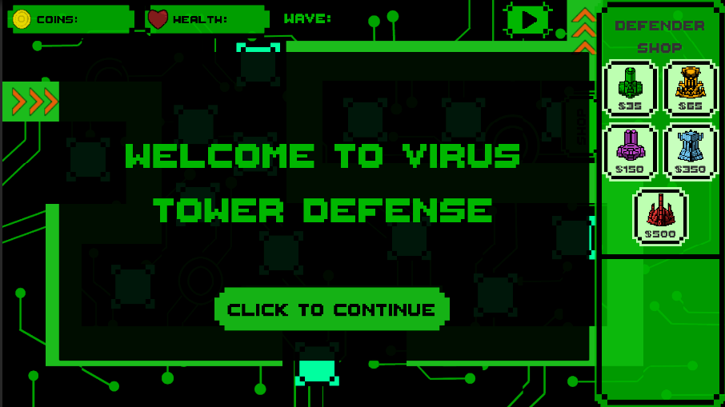
Virus Tower Defense
Start Wave Button
Health
Coins
Wave #
Virus Image
Pay attention to details prompted
Click to start the game

Slide 28
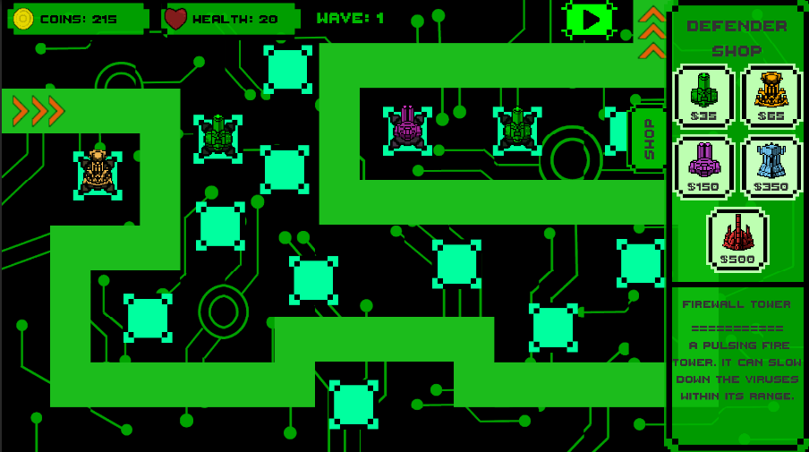
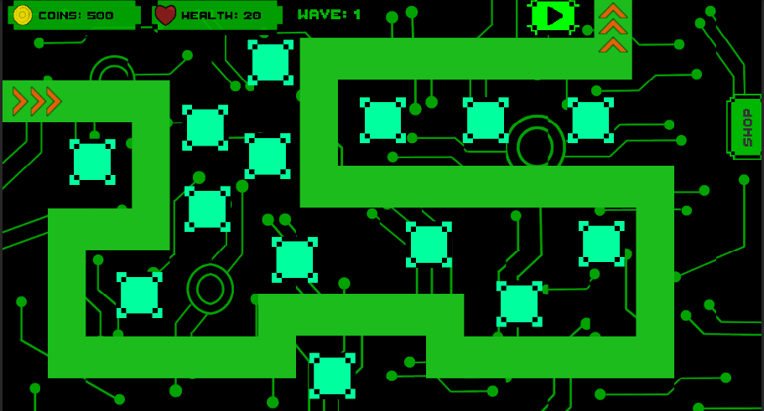
Virus Tower Defense
Tower Shop
Virus leaves here
Drag turrets to the placeholders
Virus enters here
Tower Description
Don’t let the virus reach the end or else it will deplete your health!

Slide 29
[Let’s Play]
Rebooting Computers..
Importing Files..
Loading Pizza Heist..

Slide 30

How To Get To Pizza Heist
URL: danielto29.itch.io/pizza-heist
Go to itch.io
Search Pizza Heist
Game should be first result!

Slide 31
[Thank You]
Loading End Scene..
Asking Questions..
Inquiring Comments..

